Slide 1
Credit Card Users Default Prediction Using Machine Learning
Speaker:
Faseeh U Rehman Qureshi (110188603)
Yuhan Xiang (110182721)

Slide 2

Content
Objective
Dataset Overview
Key EDA Findings
Data Preprocessing
Model Training & Evaluation
Model Comparison
Conclusion & Insights
Future Work

Slide 3

Objective
Predict whether a credit card user will default on payment next month.
Help financial institutions reduce credit risk and improve financial stability.
Explore and compare multiple ML models for predictive performance and business applicability.

Slide 4
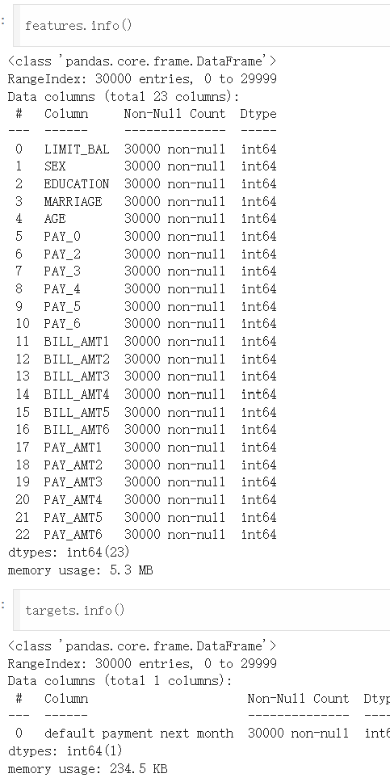
Dataset Overview
Source: UCI “Default of Credit Card Clients” (ID 350)
Size: 30,000+ records, 23 features
Features: Credit limit, payment history, bill amounts, demographics
Target Variable: default.payment.next.month (binary)

Slide 5

Key EDA Findings

Slide 6
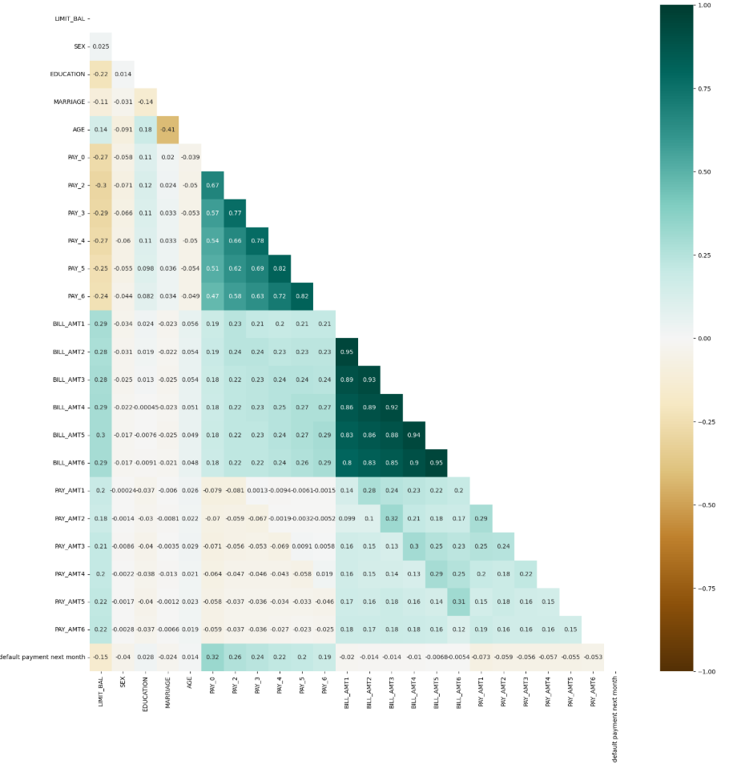
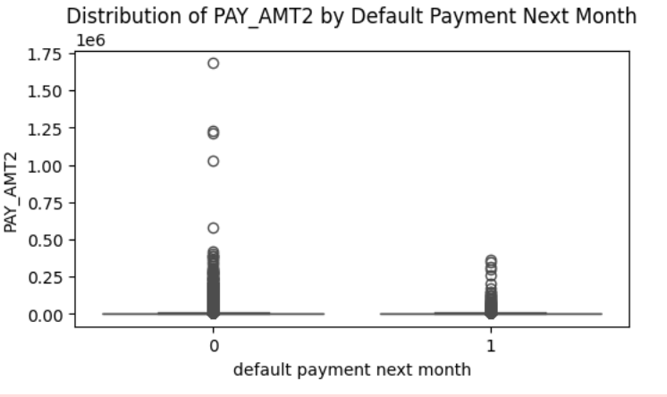
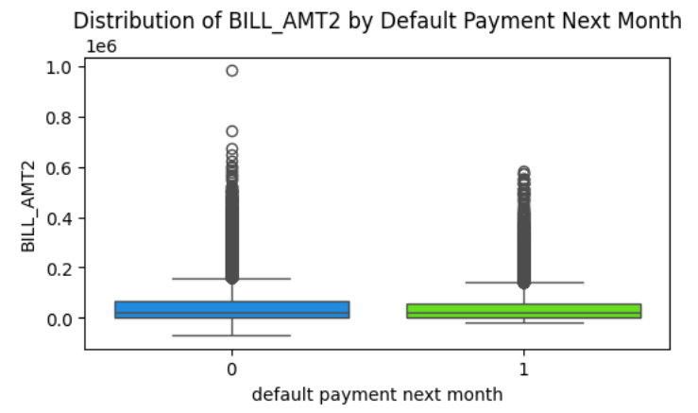
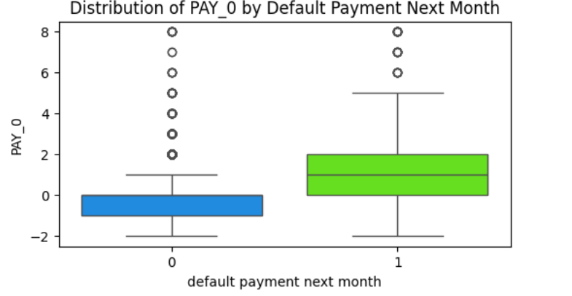
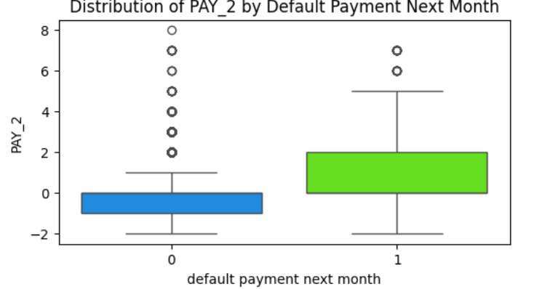
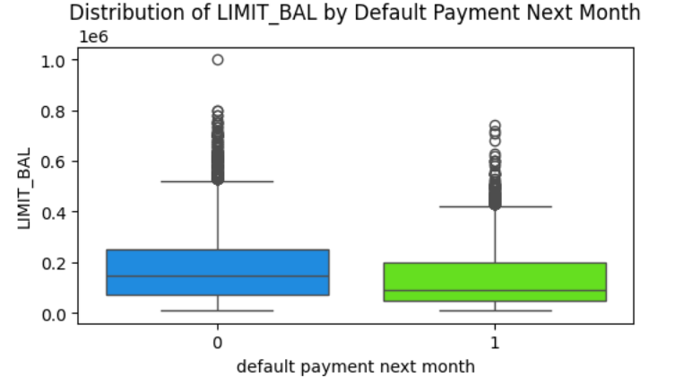
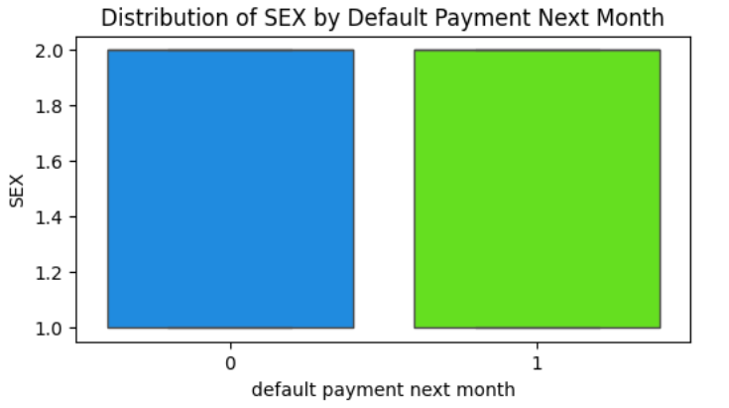
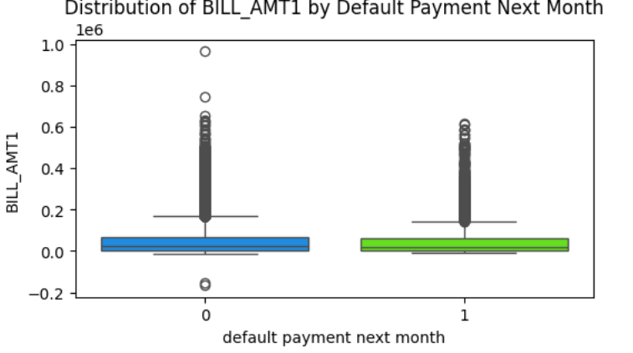
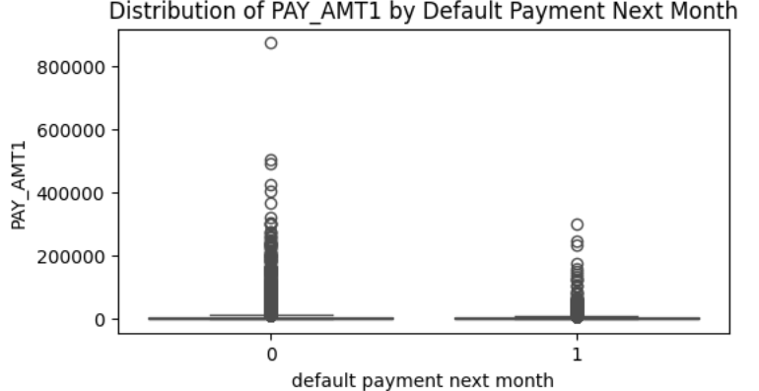
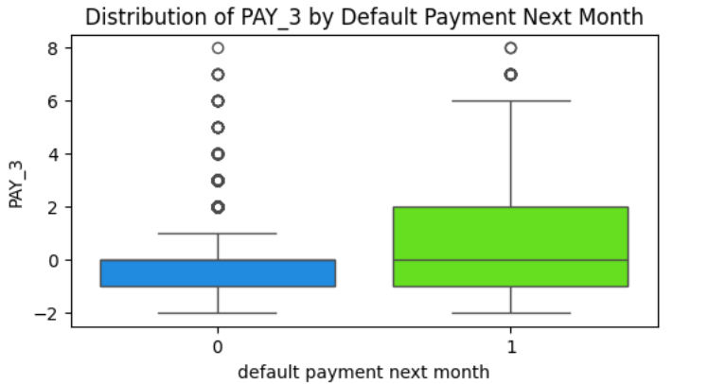
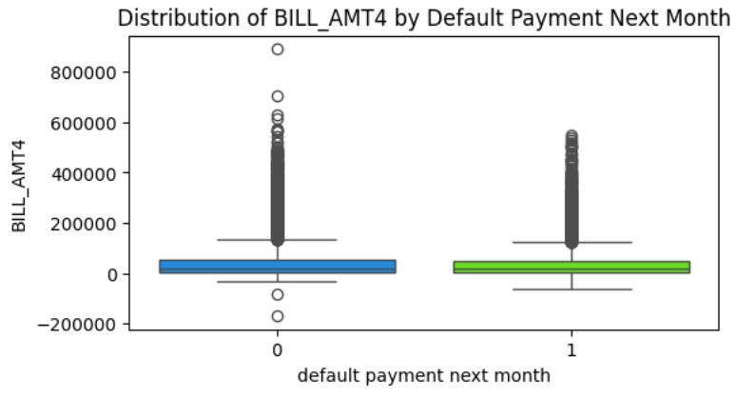
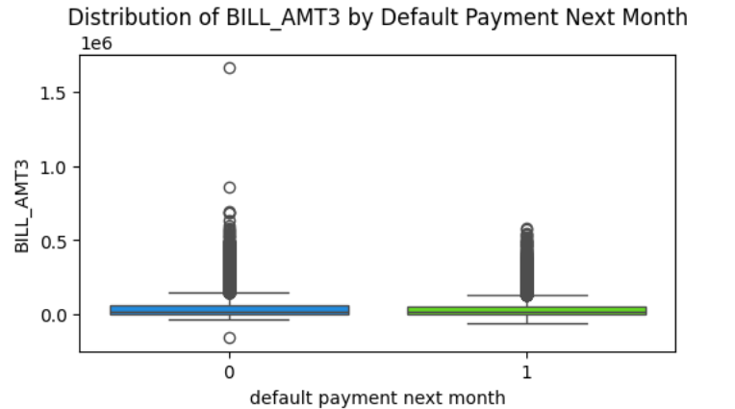
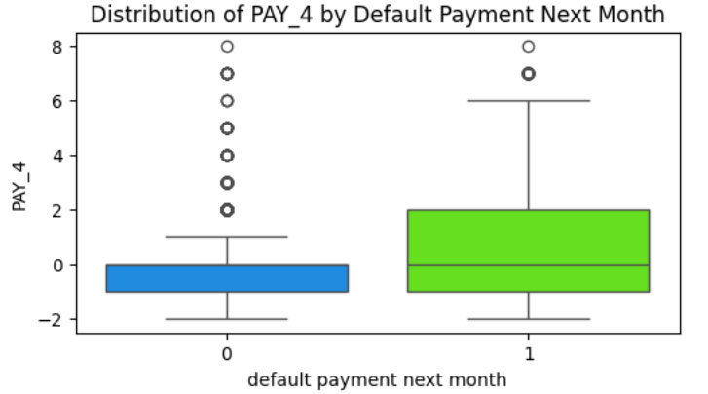
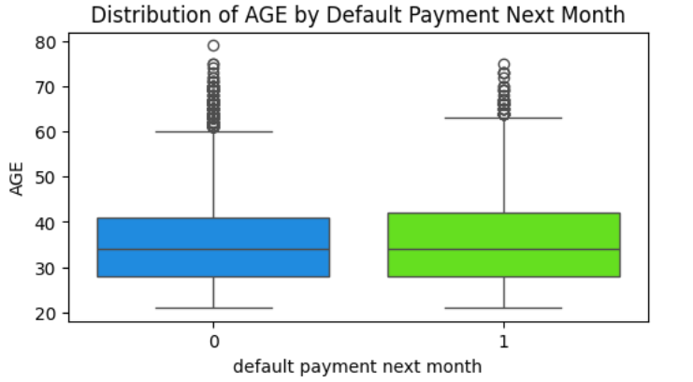
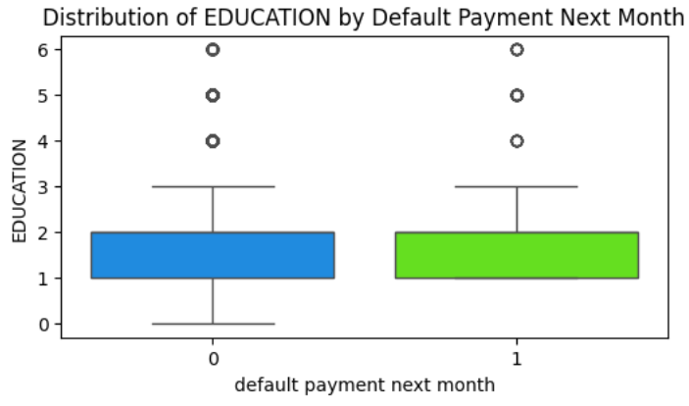
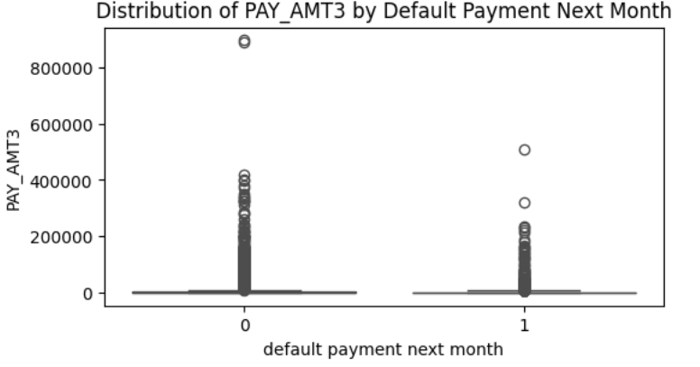
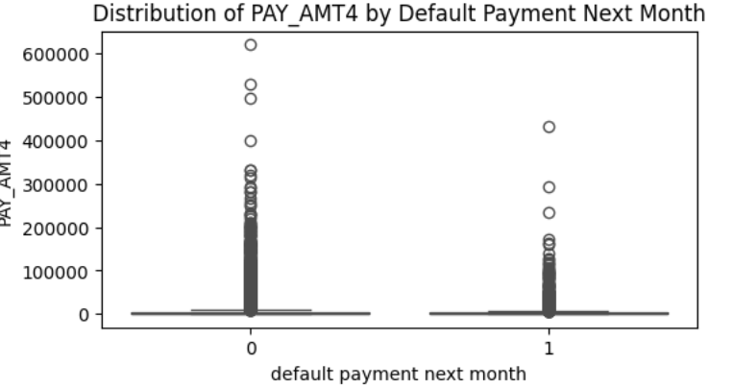
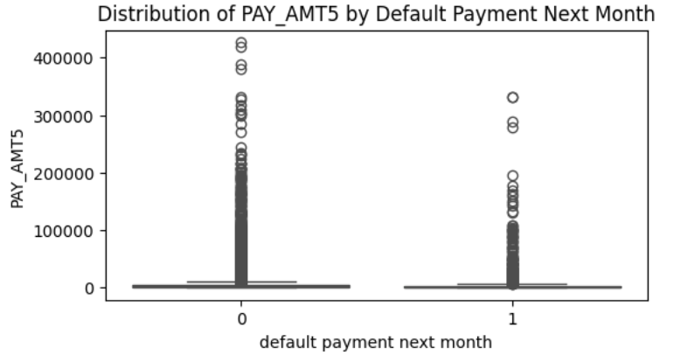
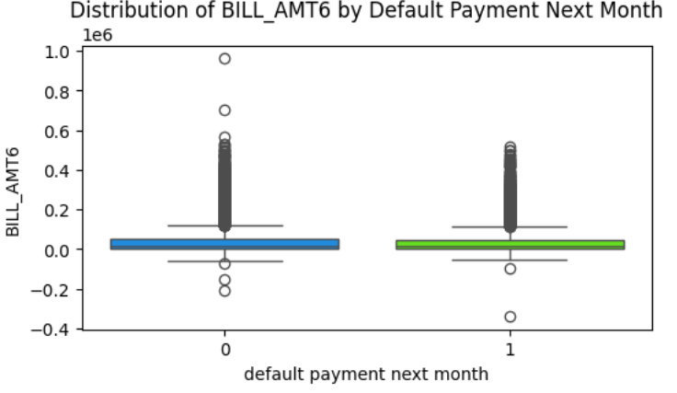
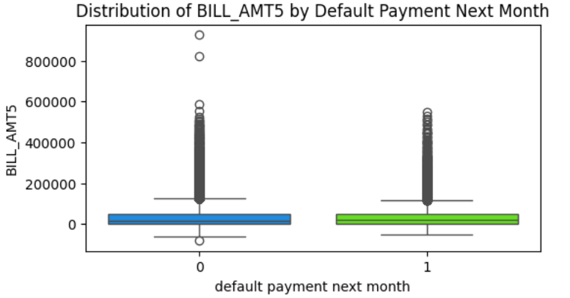
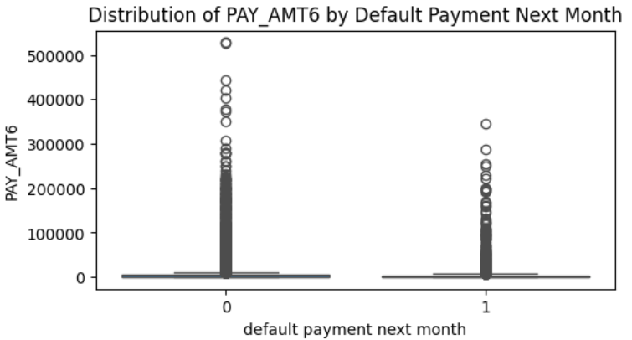
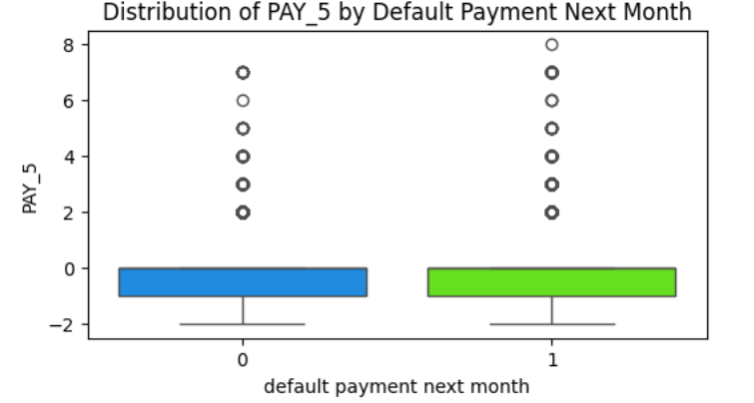
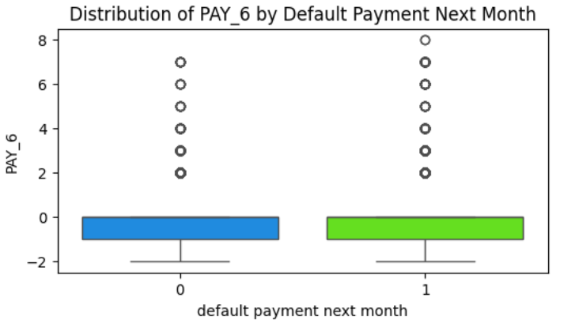
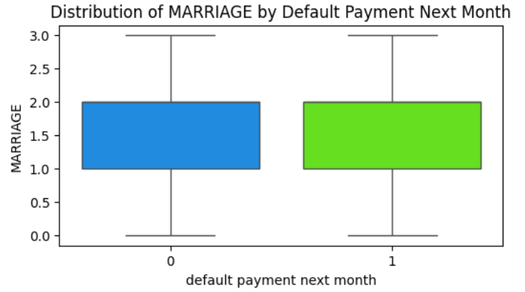
Correlation: High multicollinearity among 6-month billing/payment records
Boxplots: Clear differences in credit limit, age, and billing amounts between default and non-default groups
Distribution: Presence of skewed financial variables, requiring normalization

Slide 7
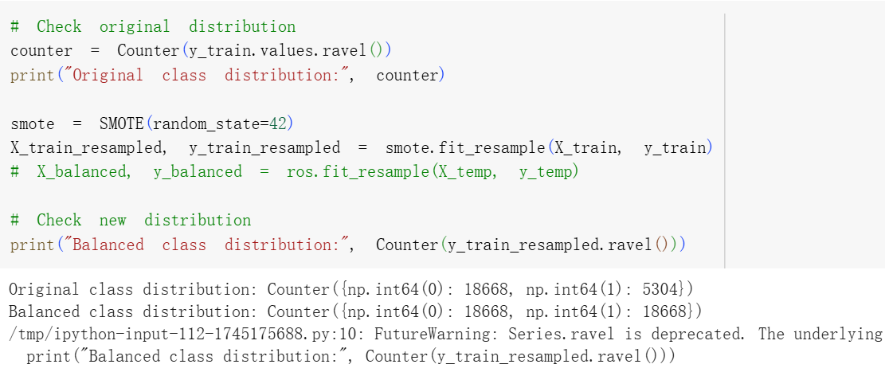
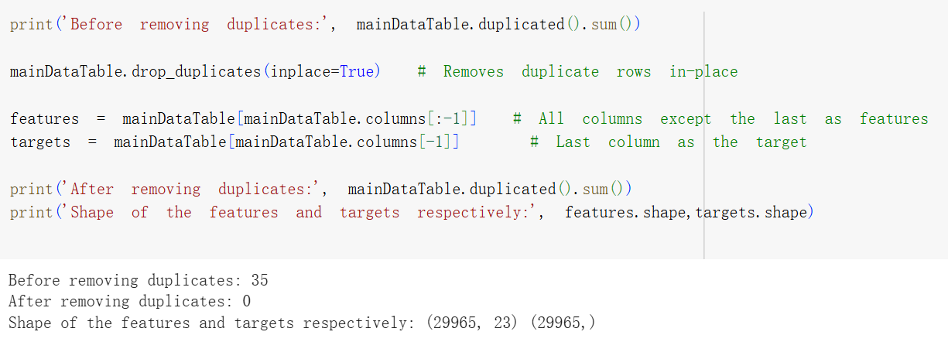
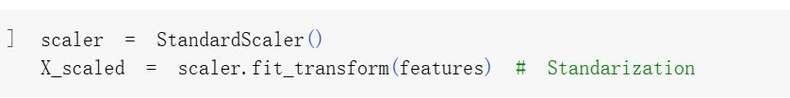
Data Preprocessing
Duplicate removal
Feature scaling: StandardScaler (used for LR, KNN, GNB)
Train-test split: 80% / 20%
Class imbalance: Handled using SMOTE (default rate ≈ 22%)

Slide 8
Model Training & Evaluation
Decision Tree Model (DTC)
Logistic Regression (LR)
K-Nearest Neighbors (KNN)
Gaussian Naive Bayes (GNB)

Slide 9
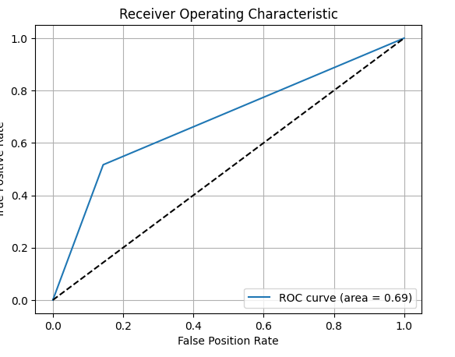
Decision Tree Model (DTC)
Model | Parameters | Train Acc | Test Acc | Notes
DTCa | depth=5 | 71.03% | 77.37% | Balanced, generalizable
DTCb | depth=7 | 72.35% | 78.14% | Best trade-off
DTCc | depth=10 | 76.46% | 72.80% | Overfitting risk

Slide 10
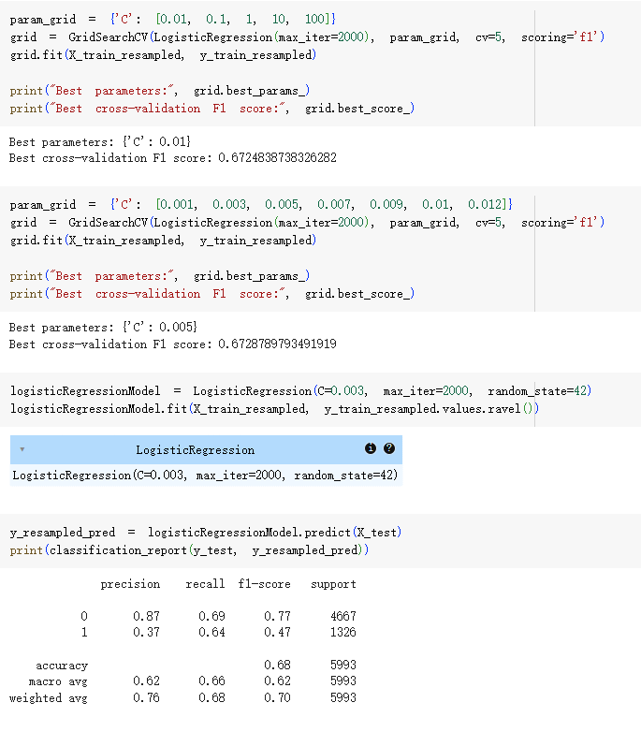
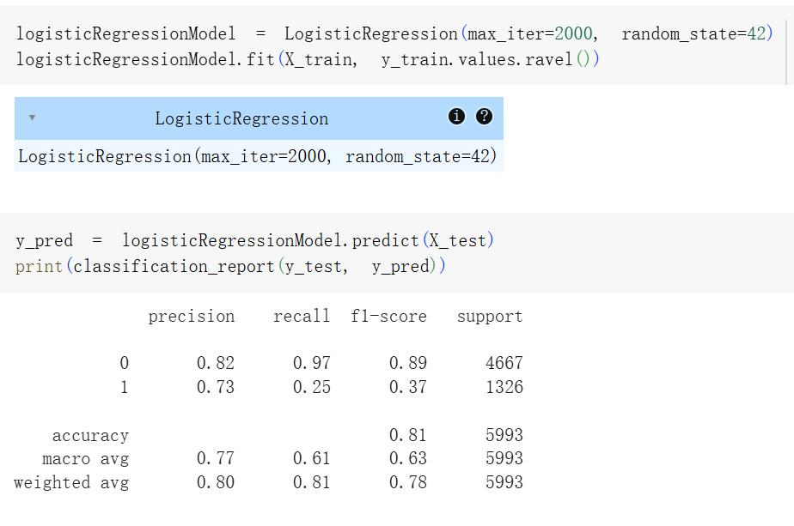
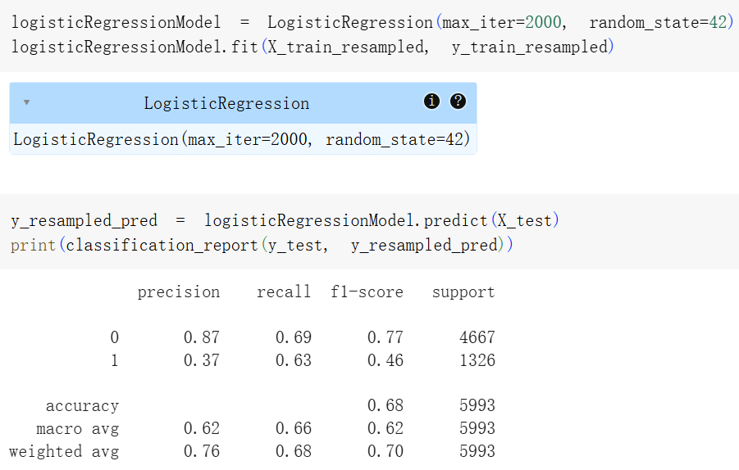
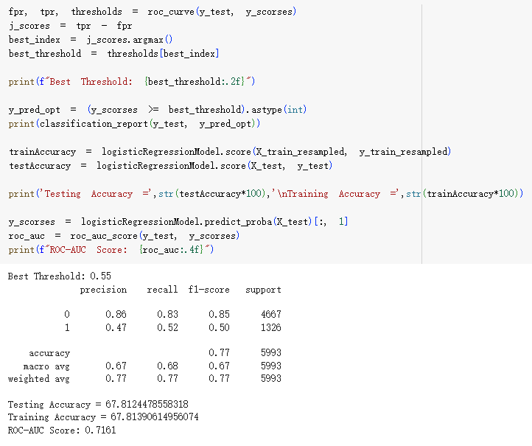
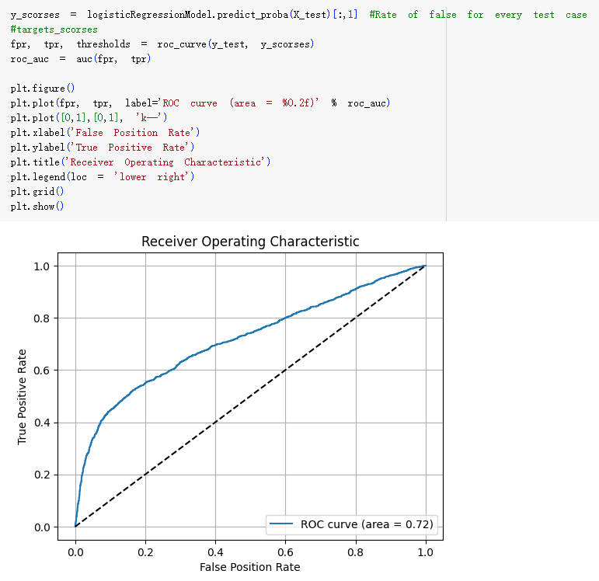
Logistic Regression (LR)
4 Evaluation Phases:
Unbalanced → poor recall for default class
SMOTE applied → improved F1 and recall
Tuned: C = 0.003 → F1 = 0.47
Threshold adjusted to 0.55 → F1 = 0.50, Accuracy = 77%
ROC-AUC = 0.72 → Stable and interpretable model

Slide 11
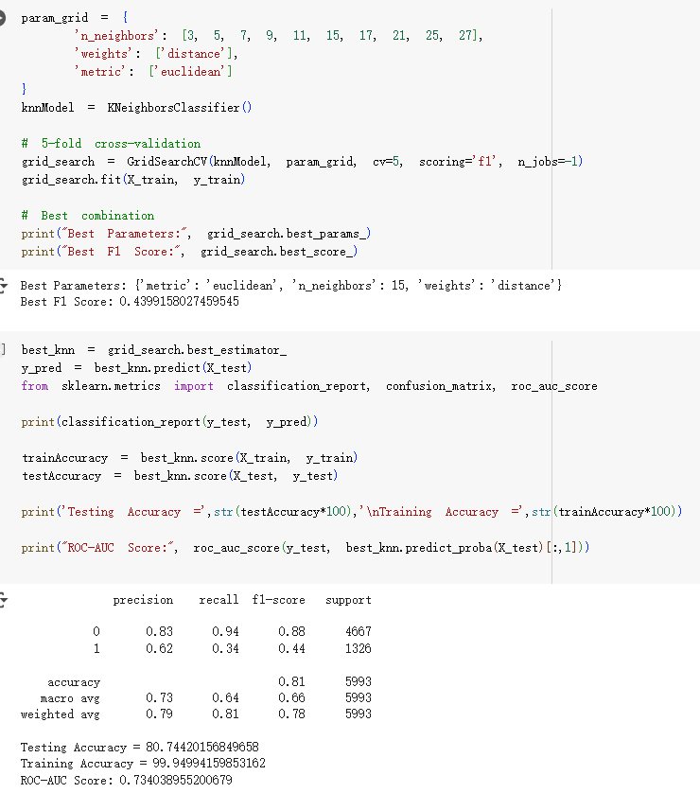
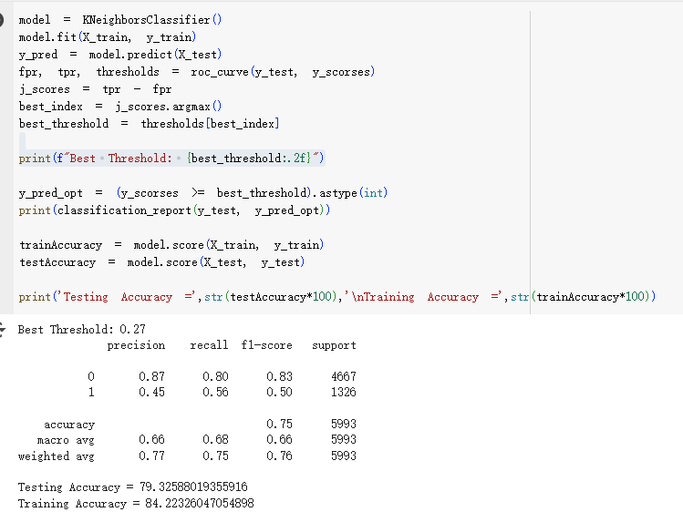
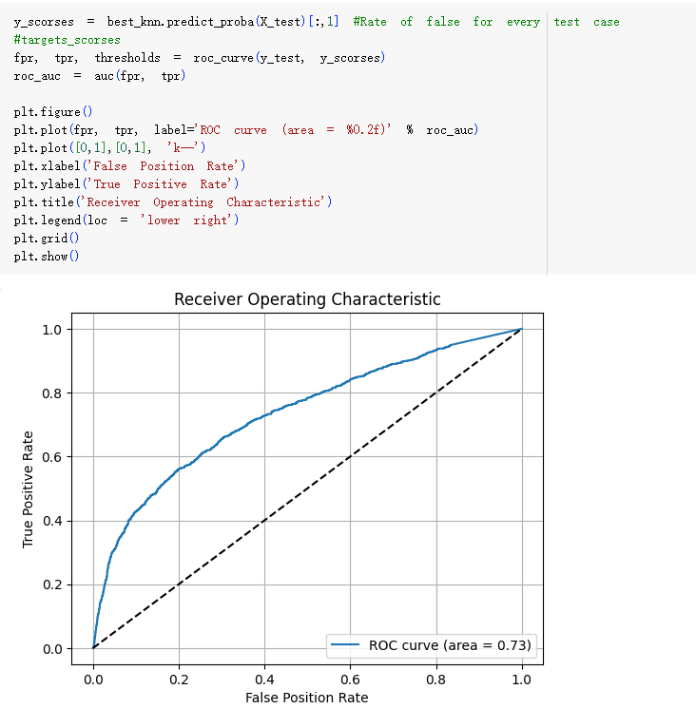
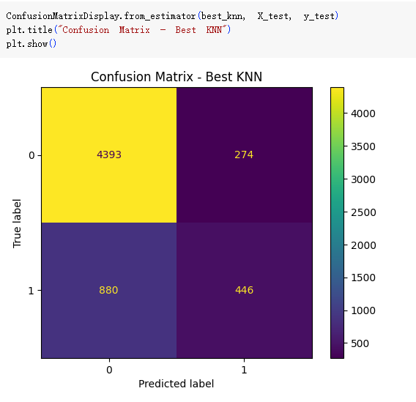
K-Nearest Neighbors (KNN)
Best config: k = 15, weighted, Euclidean
Train Accuracy = 100% (overfitting)
Test Accuracy = 81%, AUC = 0.73
Sensitive to scaling and computationally expensive for large datasets

Slide 12
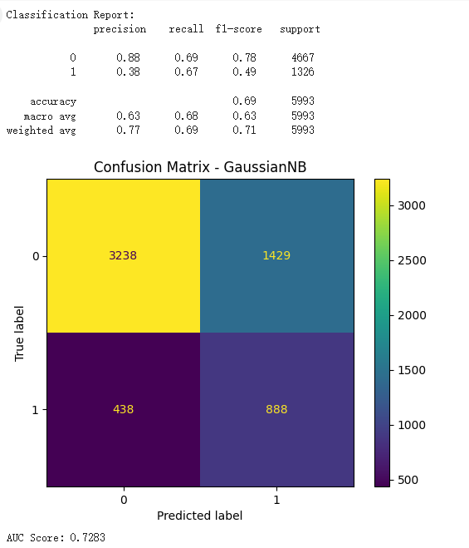
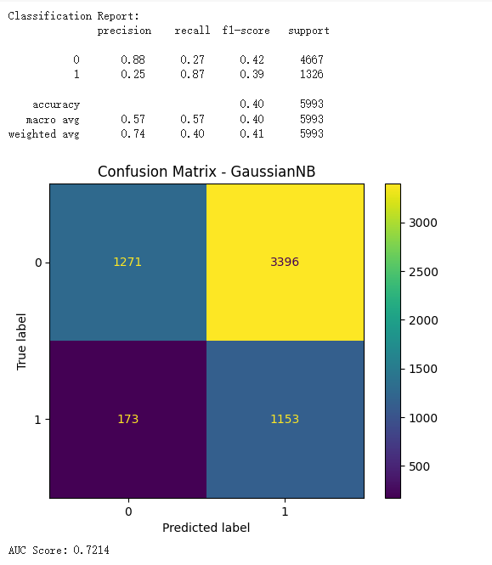
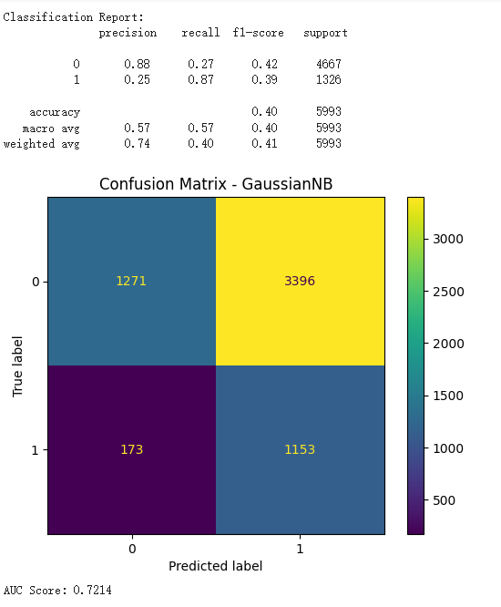
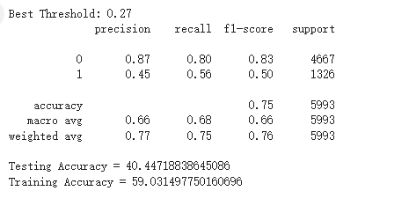
Gaussian Naive Bayes (GNB)
Assumes feature independence & Gaussian distribution
Train Accuracy = 59% | Test Accuracy = 40%
Very fast and simple, but low recall for minority class
Tunning step:
Unbalanced
SMOTE applied
var_smoothing=1e-05
Threshold adjusted to 0.27

Slide 13
Model Comparison
Model | Train Acc | Test Acc | Precision(y=1） | ROC-AUC
Logistic Regression (C=0.003) | 68% | 68% | 0.47 | 0.72
Decision Tree (DTCb) | 72% | 78% | 0.51 | 0.73
KNN (k=15) | 100% | 81% | 0.62 | 0.73
Gaussian NB（ var_smoothing=1e-05） | 59% | 40% | 0.45 | 0.72

Slide 14
Conclusion & Insights
Best model: Decision Tree (DTCb) offers optimal balance between performance and interpretability
Business Insights:
Even basic models like LR perform well with proper preprocessing
Be cautious of KNN overfitting; GNB can serve as a fast baseline
ML models can guide financial institutions in managing credit risk proactively

